Slide 1
Examples of Two-Dimensional Systolic Arrays

Slide 2
Obvious Matrix Multiply
Columns of b
distributed to
each PE in column.
Rows of a
distributed to
each PE in row.
Row x Column
on respective PEs.

Slide 3
Multiplication Here the matrix B is Transposed!
Each PE function is to first multiply and then add.
PE _{ij} ⇒ C_{ij}
B_{n1}
B₁₃ B₂₂ B₃₁
B₁₂ B₂₁
B₁₁
A_{1n}……A₁₂ A₁₁
PE
PE
PE
PE
… A₂₂ A₂₁
PE
PE
PE
PE
…..A₃₁
A_{n1}
PE
PE
PE
PE

Slide 4
Example 4: A Related Algorithm:
Cannon’s Method
Let’s take another view of systolic multiplication:
  Consider the rows and columns of the matrices to be multiplied as strips that are slide past each other.
The strips are staggered so that the correct elements are multiplied at each time step.

Slide 5
First step
columns of b (inverted)
wavefront
multiplication taking place
rows of a (reversed)

Slide 6
Second step
columns of b (inverted)
wavefront
rows of a (reversed)

Slide 7
Third step
columns of b (inverted)
wavefront
rows of a (reversed)

Slide 8
Fourth step
columns of b (inverted)
rows of a (reversed)
wavefront

Slide 9
Fifth step
columns of b (inverted)
rows of a (reversed)
wavefront

Slide 10
Cannon’s Method
Rather than have some processors idle,
  wrap the array rows and columns so that every processor is doing something on each step.
In other words, rather than feeding in the elements, they are rotated around,
  starting in an initially staggered position as in the systolic model.
We also change the order of products slightly, to make it correspond to more natural storage by rows and columns.

Slide 11
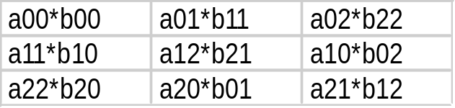
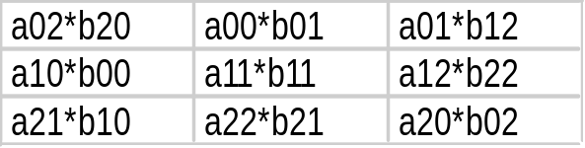
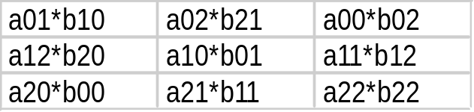
Cannon Variation
Note that the a diagonal is in the left column and the b diagonal is in the top row.
a_{0,0}
a_{0,1}
a_{0,2}
b_{0,0}
b_{1,1}
b_{2,2}
b_{1,0}
b_{2,1}
b_{0,2}
a_{1,1}
a_{1,2}
a_{1,0}
b_{2,0}
b_{0,1}
b_{1,2}
a_{2,2}
a_{2,0}
a_{2,1}
Example sum: c_{0,2} = a_{0,2}*b_{2,2} + a_{0,1}*b_{1,2} + a_{0,0}*b_{0,2}
Products computed at each step:
Step 3
Step 1
Step 2

Slide 12
Application of Cannon’s Technique
Consider matrix multiplication of 2 n x n matrices on a distributed memory machine, on say, n² processing elements.
An obvious way to compute is to think of the PE’s as a matrix, with each computing one element of the product.
We would send each row of the matrix to n processors and each column to n processors.
In effect, in the obvious way, each matrix is stored a total of n times.

Slide 13
Cannon’s Method
Cannon’s method avoids storing each matrix n times, instead cycling (“piping”) the elements through the PE array.
(It is sometimes called the “pipe-roll” method.)
The problem is that this cycling is typically too fine-grain to be useful for element-by-element multiply.

Slide 14
Partitioned Multiplication
Partitioned multiplication divides the matrices into blocks.
It can be shown that multiplying the individual blocks as if elements of matrices themselves gives the matrix product.

Slide 15
Block Multiplication
one block of product
columns of
blocks
rows of
blocks

Slide 16
Cannon’s Method is Fine for
Block Multiplication
The blocks are aligned initially as the elements were in our description.
At each step, entire blocks are transmitted down and to the left of neighboring PE’s.
Memory space is conserved.

Slide 17
Exercise
Analyze the running time for the block version of Cannon’s method for two n x n matrices on p processors, using t_{comp} as the unit operation time and t_{comm} as the unit communication time and t_{start} as the per-message latency .
Assume that any pair of processors can communicate in parallel.
Each block is (n/sqrt(p)) x (n/sqrt(p)).

Slide 18
Example 6: Fox’s Algorithm
This algorithm is also for block matrix multiplication; it has a resemblance to Cannon’s algorithm.
The difference is that on each cycle:
  A row block is broadcast to every other processor in the row.
  The column blocks are rolled cyclically.

Slide 19
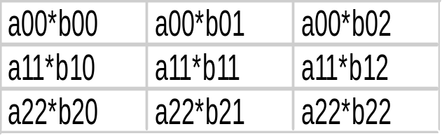
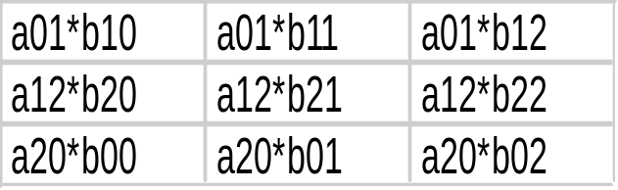
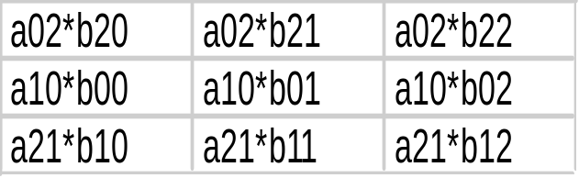
Fox’s Algorithm
Step 1
A different row block of a
is broadcast in each step.
Step 2
b columns are rolled
Step 3

Slide 20
Synchronous Computations

Slide 21
Barriers
Mentioned earlier
Synchronize all of a group of processes
Used in both distributed and shared-memory
Issue: Implementation & cost

Slide 22
Counter Method for Barriers
One-phase version
  Use for distributed-memory
  Each processor sends a message to the others when barrier reached.
  When each processor has received a message from all others, the processors pass the barrier

Slide 23
Counter Method for Barriers
Two-phase version
  Use for shared-memory
  Each processor sends a message to the master process.
  When the master has received a message from all others, it sends messages to each indicating they can pass the barrier.
  Easily implemented with blocking receives, or semaphores (one per processor).

Slide 24
Tree Barrier
Processors are organized as a tree, with each sending to its parent.
Fan-in phase: When the root of the tree receives messages from both children, the barrier is complete.
Fan-out phase: Messages are then sent down the tree in the reverse direction, and processes pass the barrier upon receipt.

Slide 25
Butterfly Barrier
Essentially a fan-in tree for each processor, with some sharing toward the leaves.
Advantage is that no separate fan-out phase is required.

Slide 26
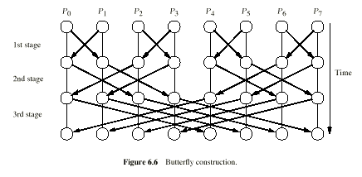
Butterfly Barrier

Slide 27
Barrier Bonuses
To implement a barrier, it is only necessary to increment a count (shared memory) or send a couple of messages per process.
These are communications with null content.
By adding content to messages, barriers can have added utility.

Slide 28
Barrier Bonuses
These can be accomplished along with a barrier:
  Reduce according to binary operator (esp. good for tree or butterfly barrier)
  All-to-all broadcast

Slide 29
Data Parallel Computations
forall statement:
forall( j = 0; j < n; j++ )
{
… body done in parallel for all j ...
}

Slide 30
forall synchronization assumptions
There are different interpretations of forall, so you need to “read the fine print”.
Possible assumptions from weakest to strongest:
  No implied synchronization
  Implied barrier at the end of each loop body
  Implied barrier before each assignment
  Each machine instruction synchronized, SIMD-fashion

Slide 31
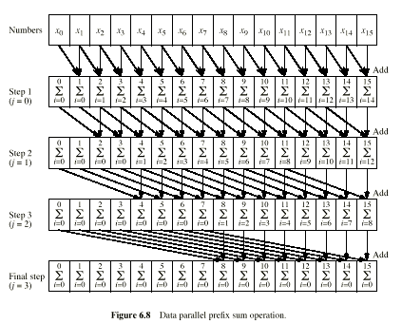
Example: Prefix-Sum

Slide 32
Example: Prefix-Sum
Assume that n is a power of 2.
Assume shared memory.
Assume barrier before assignments
for( j = 0; j < log(n); j++ )
forall( i = 2^{j}; i < n; i++)
x[i] += x[i -2^{j}];
old value
effectively buffered new value

Slide 33
Implementing forall using SPMD:
Assuming PP: “Synchronous Iteration” (barrier at end of body)
for( j = 0; j < log(n); j++ )
forall( i = 0; i < n; i++)
Body(i);
implementable in SPMD as:
for( j = 0; j < log(n); j++ )
{
i = my_process_rank();
Body(i);
barrier();
}
Outer
forall processes
implicit

Slide 34
Example:
Iterative Linear Equation Solver
for( iter = 0; iter < numIterations; iter++ )
forall( i = 0; i < n; i++)
{
double sum = 0;
for( j = 0; j < n; j++ )
sum += a[i][j]*x[j];
x[i] = sum;
}
Note:
Local memory
for each i.
barrier desired here

Slide 35
Iterative Linear Equation Solver:
Translation to SPMD
Outer
forall processes
implicit
for( iter = 0; iter < numIterations; iter++ )
{
i = my_process_rank();
double sum = 0;
for( j = 0; j < n; j++ )
sum += a[i][j]*x[j];
new_x[i] = sum;
all gather new_x to x (implied barrier)
}

Slide 36
Nested forall’s
for( iter = 0; iter < numIterations; iter++ )
forall( i = 0; i < m; i++)
forall( j = 0; j < n; i++)
Body(i, j)

Slide 37
Example of nested forall’s:
Laplace Heat equation
for( iter = 0; iter < numIterations; iter++ )
forall( i = 0; i < m; i++)
forall( j = 0; j < n; i++)
x[i][j] = (x[i-1][j] + x[i][j-1] + x[i+1][j] + x[i][j+1])/4.0;

Slide 38
Exercise
How would you translate nested forall’s to SPMD?

Slide 39
Synchronous Computations
Synchronous computations have the form
    (Barrier)
    Computation
    Barrier
    Computation
    …
Frequency of the barrier and homogeneity of the intervening computations on the processors may vary
We’ve seen some synchronous computations already (Jacobi2D, Systolic MM)

Slide 40
Synchronous Computations
Synchronous computations can be simulated using asynchronous programming models
  Iterations can be tagged so that the appropriate data is combined
Performance of such computations depends on the granularity of the platform, how expensive synchronizations are, and how much time is spent idle waiting for the right data to arrive

Slide 41
Barrier Synchronizations
Barrier synchronizations can be implemented in many ways:
  As part of the algorithm
  As a part of the communication library
    PVM and MPI have barrier operations
  In hardware
Implementations vary

Slide 42
Review
What is time balancing? How do we use time-balancing to decompose Jacobi2D for a cluster?
Describe the general flow of data and computation in a pipelined algorithm. What are possible bottlenecks?
What are the three stages of a pipelined program? How long will each take with P processors and N data items?
Would pipelined programs be well supported by SIMD machines? Why or why not?
What is a systolic program? Would a systolic program be efficiently supported on a general-purpose MPP? Why or why not?

Slide 43
Common Parallel Programming Paradigms
Embarrassingly parallel programs
Workqueue
Master/Slave programs
Monte Carlo methods
Regular, Iterative (Stencil) Computations
Pipelined Computations
Synchronous Computations

Slide 44
Synchronous Computations
Synchronous computations are programs structured as a group of separate computations which must at times wait for each other before proceeding
Fully synchronous computations = programs in which all processes synchronized at regular points
Computation between synchronizations often called stages

Slide 45
Synchronous Computation Example: Bitonic Sort
Bitonic Sort an interesting example of a synchronous algorithm
Computation proceeds in stages where each stage is a (smaller or larger) shuffle-exchange network
Barrier synchronization at each stage

Slide 46
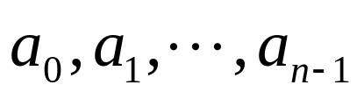
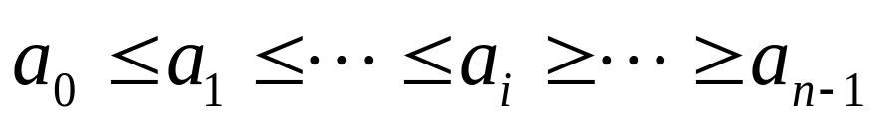






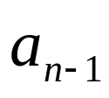
Bitonic Sort
A bitonic sequence is a list of keys
such that
  For some i, the keys have the ordering
  or
  The sequence can be shifted cyclically so that 1) holds

Slide 47
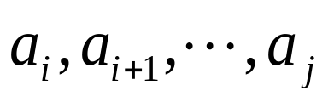
Bitonic Sort Algorithm
The bitonic sort algorithm recursively calls two procedures:
  BSORT(i,j,X) takes bitonic sequence and produces a non-decreasing (X=+) or a non-increasing sorted sequence (X=-)
  BITONIC(i,j) takes an unsorted sequence and produces a bitonic sequence
The main algorithm is then
  BITONIC(0,n-1)
  BSORT(0,n-1,+)

Slide 48
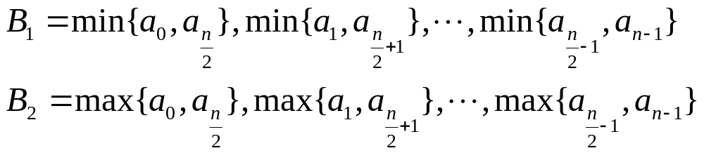


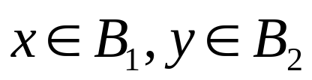
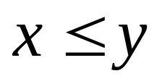
How does it do this?
We’ll show how BSORT and BITONIC work but first consider an interesting property of bitonic sequences:
Assume that is bitonic and that n is even. Let
Then and are bitonic sequences and for all

Slide 49
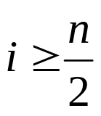
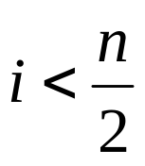

Picture “Proof” of Interesting Property
Consider
Two cases: and

Slide 50
Picture “Proof” of Interesting Property
Consider

Slide 51
Picture “Proof” of Interesting Property
Consider

Slide 52

Back to Bitonic Sort
Remember
  BSORT(i,j,X) takes bitonic sequence and produces a non-decreasing (X=+) or a non-increasing sorted sequence (X=-)
  BITONIC(i,j) takes an unsorted sequence and produces a bitonic sequence
Let’s look at BSORT first …
min bitonic
max bitonic
bitonic
sorted

Slide 53
Here’s where the shuffle-exchange comes in …
Shuffle-exchange network routes the data correctly for comparison
At each shuffle stage, can use + switch to separate B1 and B2
a
b
+
min{a,b}
max{a,b}
shuffle
unshuffle
+
min bitonic
subsequence
max bitonic
subsequence
+
bitonic
+
+

Slide 54
Sort bitonic subsequences to get a sorted sequence
BSORT(i,j,X)
  If |j-i|<2 then return [min(i,i+1), max(i,i+1)]
  Else
    Shuffle(i,j,X)
    Unshuffle(i,j)
    Pardo
      BSORT (i,i+(j-i+1)/2 - 1,X)
      BSORT (i+(j-i+1)/2 +1,j,X)
shuffle
unshuffle
+
Sort
mins
+
bitonic
+
Sort
maxs
+

Slide 55
BITONIC takes an unsorted sequence as input and returns a bitonic sequence
BITONIC(i,j)
  If |j-i|<2 then return [i,i+1]
  Else
    Pardo
      BITONIC(i,i+(j-i+1)/2 – 1); BSORT (i,i+(j-i+1)/2 - 1,+)
      BITONIC(i+(j-i+1)/2 +1,j); BSORT (i+(j-i+1)/2 +1,j,-)
(note that any 2 keys are
already a bitonic sequence)
a
b
-
max{a,b}
min{a,b}
Sort
first
half
+
}
-
unsorted
2-way
bitonic
4-way
bitonic
8-way
bitonic
+
}
Sort
second
half
-

Slide 56
Putting it all together
Bitonic sort for 8 keys:
a
b
a
b
+
+
+
+
+
+
-
+
+
+
+
+
+
-
-
+
+
+
-
-
-
+
+
+
unsorted
8-way
bitonic
2 ordered
bitonics
Sorted
sequence
4-way
bitonics
4 ordered
2-way
bitonics

Slide 57
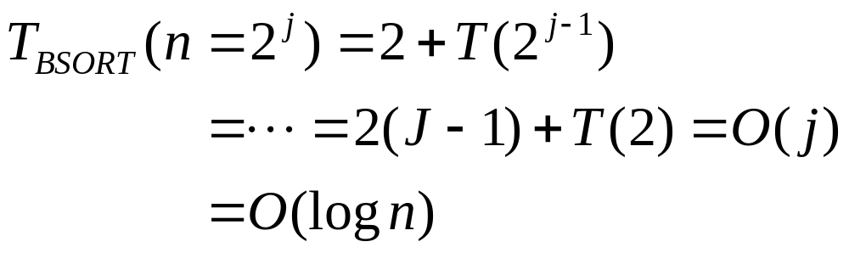
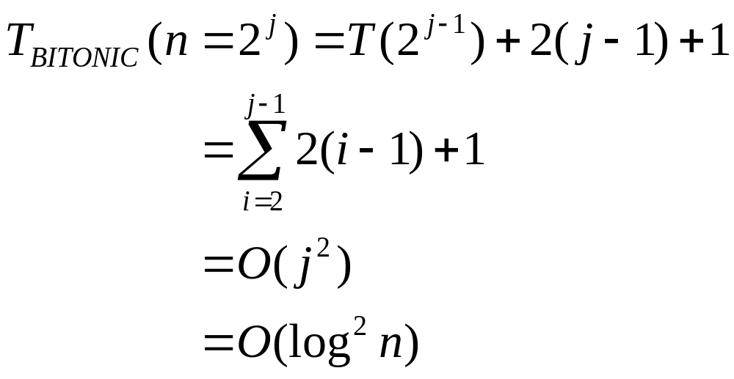
Complexity of Bitonic Sort

Slide 58
Programming Issues
Flow of data is assumed to transfer from stage to stage synchronously; usual issues with performance if algorithm is executed asynchronously
Note that logical interconnect for each problem size is different
  Bitonic sort must be mapped efficiently to target platform
Unless granularity of platform very fine, multiple comparators will be mapped to each processor

Slide 59
Review
What is a a synchronous computation? What is a fully synchronous computation?
What is a bitonic sequence?
What do the procedures BSORT and BITONIC do?
How would you implement Bitonic Sort in a performance-efficient way?

Slide 60
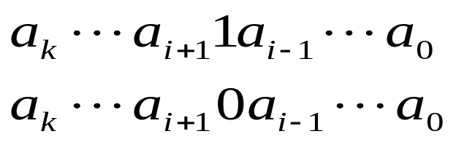
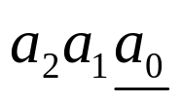
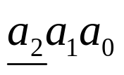
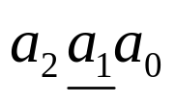
Mapping Bitonic Sort
For every stage the 2X2 switches compare keys which differ in a single bit
000
+
+
+
+
+
+
001
010
-
+
+
+
+
+
011
100
+
-
-
+
+
+
101
110
-
-
-
+
+
+
111

Slide 61
Supporting Bitonic Sort on a hypercube
Switch comparisons can performed in constant time on hypercube interconnect.
4
4
5
5
0
1
X
Y
0
1
X
Compare(X,Y)
6
7
6
7
Min{X,Y}
Max{X,Y}
2
3
2
3

Slide 62
Mappings of Bitonic Sort
Bitonic sort on a multistage full shuffle
  Small shuffles do not map 1-1 to larger shuffles!
  Stone used a clever approach to map logical stages into full-sized shuffle stages while preserving O(log^2 n) complexity
?

Slide 63

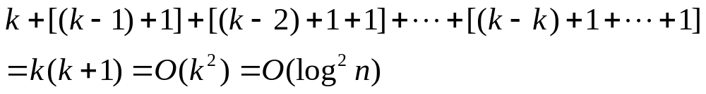
Outline of Stone’s Method
Pivot bit = index being shuffled
Stone noticed that for successive stages, the pivot bits are
If the pivot bit is in place, each subsequent stage can be done using a full-sized shuffle (a_0 done with a single comparator)
For pivot bit j, need k-j full shuffles to position bit j for comparison
Complexity of Stone’s method:

Slide 64
Many-one Mappings of Bitonic Sort
For platforms where granularity is coarser, it will be more cost-efficient to map multiple comparators to one processor
Several possible conventional mappings
Compare-split provides another approach …
+
+
-
+
-
+
-
-
-
-
-
-
-
-
-
+
-
-
-
-
+
-

Slide 65
Compare-Split
For a block of keys, may want to use a compare-split operation (rather than compare-exchange) to accommodate multiple keys at a processor
Idea is to assume that each processor is assigned a block of keys, rather than 2 keys
  Blocks are already sorted with a sequential sort
  To perform compare-split, a processor compares blocks and returns the smaller half of the aggregate keys as the min block and the larger half of the aggregate keys as the max block
Block A
Compare-
split
Min Block
Block B
Max Block

Slide 66
Compare-Split
Each Block represents more than one datum
  Blocks are already sorted with a sequential sort
  To perform compare-split, a processor compares blocks and returns the smaller half of the aggregate keys as the min block and the larger half of the aggregate keys as the max block
Block A
Compare-
split
Min Block
Block B
Max Block
+
+
+
+
+
+
-
+
+
+
+
+
+
-
-
+
+
+
-
-
-
+
+
+

Slide 67
Performance Issues
What is the complexity of compare-split?
How do we optimize compare-split?
  How many datum per block?
  How to allocate blocks per processors?
  How to synchronize intra-block sorting with inter-block communication?

Slide 68
Conclusion on Systolic Arrays
Advantages of systolic arrays are:
  1. Regularity and modular design(Perfect for VLSI implementation).
  2. Local interconnections(Implements algorithms locality).
  3. High degree of pipelining.
  4. Highly synchronized multiprocessing.
  5. Simple I/O subsystem.
  6. Very efficient implementation for great variety of algorithms.
  7. High speed and Low cost.
  8. Elimination of global broadcasting and modular expansibility.

Slide 69
Disadvantages of systolic arrays
The main disadvantages of systolic arrays are:
  1. Global synchronization limits due to signal delays.
  2. High bandwidth requirements both for periphery(RAM) and between PEs.
  3. Poor run-time fault tolerance due to lack of interconnection protocol.

Slide 70

Parallel overhead.
Running time for a program running on several processors including an allowance for parallel overhead compared with the ideal running time.
There is often a point beyond which adding further processors doesn’t result in further efficiency.
There may also be a point beyond which adding further processors results in slower execution.
Food for thought

Slide 71
1. Seth Copen Goldstein, CMU
2. David E. Culler, UC. Berkeley,
3. Keller@cs.hmc.edu
4. Syeda Mohsina Afroze and other students of Advanced Logic Synthesis, ECE 572, 1999 and 2000.
5. Berman
Sources

